Slide 1
Hill Cipher
Implemented using Haskell

Slide 2
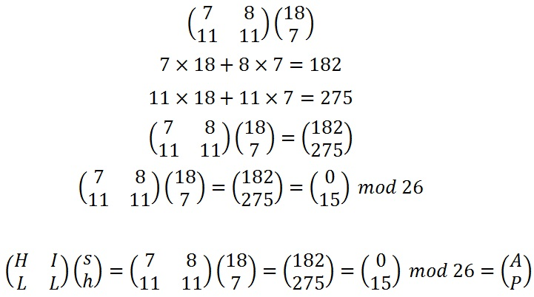
What is Hill Cipher?
In short, Matrix Multiplication!
Image 01: Encoding ‘sh’ with Hill Cipher

Slide 3
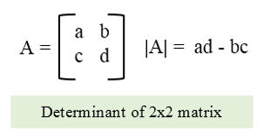
How it works: Before Encrypting
Each letter in the alphabet used is represented by a number modulo the size of the alphabet (so 26 for English)
The key matrix must be a square (n x n), invertible matrix
The determinant of the key matrix cannot share factors with the modulo
Finally, separate your message into n size chunks
Remember to pad your text and key to ensure they are the correct size!
Image 02: The most basic determinant

Slide 4
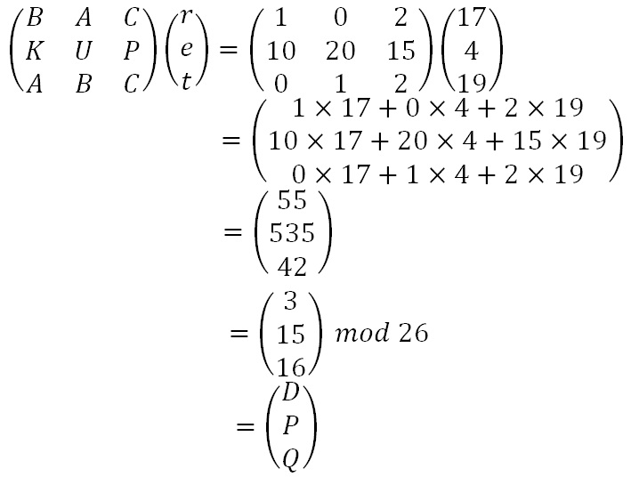
Encryption
Perform matrix multiplication on each block of your message!
Image 03: Given part ‘ret’ of ‘retreat nowxx’ and the key ‘BAC/KUP/ABC’

Slide 5
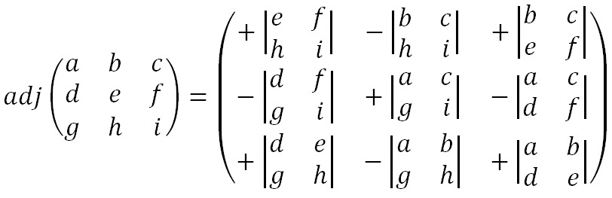
Decryption
Find the inverse of the key matrix
Multiply the inverse of the key’s determinant by the adjugate matrix of the key
In proper terms, given matrix M, determinant D, and adjugate Adj:
M⁻¹ = D⁻¹ x Adj
Then, multiply your encoded message with that inverse
Image 04: The Adjugate of a 3 x 3 matrix

Slide 6
Advantages and Disadvantages of Hill
Advantages:
Good masking of original message
Useful as an intermediary step in other ciphers, like AES, due to diffusion
Disadvantages:
Is completely linear
Becomes incredibly laborious to do by hand with longer keys/messages

Slide 7
Our Implementation
The wonderous Haskell package Data.Matrix
For simplicity, three (2x2) key matrices are provided
All text is padded ‘x’
Also, duplicate letters are separated by ‘x’ – so ‘hello’ becomes ‘helxleo’ before additional padding is added if necessary
Other information
Get some snippets for images maybe?

Slide 8
Works Cited
Image 01: Hill cipher. (n.d.). Retrieved February 26, 2021, from https://crypto.interactive-maths.com/hill-cipher.html
Image 02: C program to find determinant of a matrix. (n.d.). Retrieved February 26, 2021, from https://www.cprogramcoding.com/p/box-sizing-border-box_474.html
Before Encrypting, Encryption, and Decryption instructions: Hill cipher. (2021, January 30). Retrieved February 26, 2021, from https://en.wikipedia.org/wiki/Hill_cipher
Image 03: Hill cipher. (n.d.). Retrieved February 26, 2021, from https://crypto.interactive-maths.com/hill-cipher.html
Adjugate Matrix: Adjugate matrix. (2021, February 25). Retrieved February 26, 2021, from https://en.wikipedia.org/wiki/Adjugate_matrix
Image 04: Hill cipher. (n.d.). Retrieved February 26, 2021, from https://crypto.interactive-maths.com/hill-cipher.html
Data.Matrix Package: Matrix type. (n.d.). Retrieved February 26, 2021, from https://hackage.haskell.org/package/matrix-0.3.6.1/docs/Data-Matrix.html

